Slide 1

WELCOME
SYLVAN HILLS MIDDLE
GO TEAM MEETING
Monica Blasingame, Principal
March 10, 2020

Slide 2

Today’s Agenda
Call to Order
Roll Call; establish quorum
Action Items
  Approval of Agenda
  Approval of Previous Meeting Minutes
  FY22 Budget Approval
Discussion Items
  CARES II Funds/ Proposed Allocation
Information Items
  Principal’s Report
Announcements
Public Comment
Adjournment

Slide 3
GO TEAM MEMBERS 20-21
NAME | ROLE
Ms. Monica Blasingame | Principal
Ms. Jessica Bracey | Parent
Ms. Queen Rosa Harden-Green | Parent
Mr. Mark Gresham | Parent
Ms. Sade Miller | Staff
Mr. Derwin Purnell | Staff
Ms. Sonjyia Bryant | Staff
Ms. Keisha Mackey | Community Member
LaSandra Brown | Community Member
Ms. Alexandria Gonsalves | Swing Seat

Slide 4

Let’s commit to:
Wearing masks and socially distancing
Being present and engaging meaningfully so that we can learn from each other (i.e., Cameras on)
Refrain from using electronic devices unless required to engage in the work
Muting your microphone (VIRTUAL) and minimizing extraneous conversations
Assuming good will
Allowing all voices of the team to be heard
Focusing on the day’s content
Starting and ending on time
Being gracious

Slide 5

Action Items
.
  Approval of Agenda
  Approval of Previous Meeting Minutes
  FY22 Budget Approval

Slide 6

SY22 Budget….

Slide 7

Purpose: Budget Planning & Approval Meeting
To improve student achievement in all of our schools
To ensure the budget provides the financial structure needed to support the school's mission, vision and priorities
To discuss and collaborate on how the budget funds will be spent

Slide 8

Budget Process
Step 1: Review/ Update Strategic Plan and Priorities
Step 2: Complete Budget Training
Step 3: Principal’s Draft and GO Team Feedback
Step 4: Academic Staffing & Resource Planning Conference
Step 5: Principal Presents Final Budget for GO Team Approval

Slide 9




Sylvan Hills Middle (Carver Cluster)
District Mission & Vision
Cluster Mission & Vision
School Mission & Vision
With a caring culture of trust and collaboration, every student will graduate ready for
college and career.
A high-performing school district where students love to learn, educators inspire, families engage and the community trusts the system
Through a culture of collaboration, respect, and trust, the Carver Cluster will enhance and strengthen its overall academic programs while maintaining a sage and nurturing environment that prepares students for college and careers.
The Carver Cluster will produce high-performing, college and career ready students that are globally aware and ready to have a positive impact on society.
It is our mission to provide a learning environment that ensures high expectations for all of our scholars through quality instruction, real-world applications and technology that promotes and fosters knowledge and skills.
Sylvan Hills Middle School will provide a nurturing and safe environment where scholars become critical thinkers, problem solvers, lifelong learners, and productive citizens.
Signature Program: College And Career Prep
School Priorities
School Strategies
Key Performance
Measures
Cultivate a literate community in which students read and write with clarity and fluency across all contents
Improve students’ mathematics performance
Improve students’ enrollment and success in higher-level classes
1A. Develop, implement and monitor best writing practices across all contents. 1B.Implement a meaningful literacy/math block (SFA) that includes whole group instruction, flexible small group instruction and literacy work stations.
1C. Develop and implement a Response to Intervention (RTI) plan, beginning with strong first teaching and targeted intervention.
1D. Implement Definitions of Teaching Excellence
2A-E. Same as 1B-1F
2F. Implement weekly common assessments
2G. Focus on unit assessment performance
3A. Develop master schedule aligned with student data, needs, and high school course offerings
3B. Offer more courses that will earn high school credits
Increase students performance on GA Milestones in Reading, Writing, and Math.
Increase student performance on STAR Assessment.
Increase students performance on 4sight reading assessment (quarterly).
Improve performance on district benchmark assessment
Improve NAEP scores (8th grade only)
Increase the number of parents and community members that participate in local and state administered surveys.
Increase TKES evaluation scores
Increase overall CCRPI rating
Improve students’ attendance
Improve culture and climate ratings
Academic
Program
Foster a culture of ongoing support for teacher development.
Recruit and maintain highly talented faculty/staff trained in researched-based best for developing the total middle school student (academically, socially, and emotionally)
4A. Identify teacher growth opportunities to provide ongoing coaching support.
Communicate clear expectations and feedback to teachers.
4B. Consistently implement revised teacher induction program for staff new to Sylvan.
4C. Provide ongoing valuable staff development designed to help staff elevate the rigor in the classroom and help students utilize higher order thinking, reading and writing skills.
5A. Establish and maintain incentive program to reward faculty and staff who consistently demonstrate the highest standards of professionalism.
Talent
Management
Engage all facets of the community as partners and align people and resource to maximize impact.
6A. Build relationships between school leadership/staff and partner leadership in order to better serve the needs of the Sylvan Hills community.
6B. Strengthen family and community support to increase parent involvement.
6C. Establish and maintain communication with the community about formal and diverse engagement opportunities at Sylvan Hills.
6D. Offer ongoing surveys to students, staff, and parents to determine needs and current awareness of existing programs and community resources.
Systems &
Resources
Provide increased teaching and learning opportunities for all staff and students.
7A. Implement Social Emotional Learning (SEL) daily.
7B. Utilize the services of the Northstar Psychological Services and other providers to assist students/families.
7C. Create a culture to support and encourage our students to behave in a positive manner where they all can learn and feel protected in a safe and orderly environment
Culture

Slide 10

SHMS Priorities 2020-2021
Cultivate a literate community in which students read and write with clarity and fluency across all contents
Foster ongoing support for teacher development

Slide 11
Budget by Function
Notes:
Instruction (1000): Teachers, Instructional Paras,
Pupil Services (2100): Nurse, SSW, Parent Liaison, Behavior Specialist
Improvement of Instructional Services (2210): Instructional Coach
Educational Media Services (2220): Media Para
School Administration (2400): Principal Asst Principal Program Administrator School Business Manager - 220 days School Business Manager-Annual School Secretary Bookkeeper School Clerk (231 day) School Clerk (211 day) School Clerk (202 day) Registrar
Maintenance and Operations (2600)
Transportation

Slide 12

SHMS SY22 BUDGET.…
What does that mean?
Projected Enrollment | 513 students
Allocation | $6,204,756
Change in Enrollment | -12
Signature Program | $160,500
Turnaround | $0
Title I | $322,920
Family Engagement | $11,000
Title School Improvement | $0
Total FTE Allotments | $1,663,800
Unallocated Funds | $155,645

Slide 13

Non-Staffing
Description | Amount
Teacher Stipends | $15,000
Contracted Services | $10,000
Secretary Overtime | $500
Student Transportation/ Breeze Cards, | $1,000
Postage | $1,000
Web-based subscriptions | $20,000
APS Buses | $10,000
Teaching/ Other Supplies/ Student Incentives | $27,008
Media Supplies | $5,000
Textbooks | $29,241
Digital Textbooks | $27,189
Student Admissions | $2500
Other Stipends | $6,000

Slide 14

STAFFING UPDATES
Reductions
Signature Program Specialist (0.2 FTE)
New Positions
Media Para
Instructional Technology Coach
  *VILS – pays (0.4 FTE)
  *APS – pays (0.6 FTE)
*School Business Manager

Slide 15

CARES II
Federal Funding

Slide 16
PURPOSE
To support the effective implementation and other identified school-based needs as a result of the COVID-19 Pandemic, each school has been allocated Cares II Funding. We have outlined below the requirements and specific parameters to ensure the appropriate use of these funds.
Requirement
Funds must be used to support the implementation of the school-based intervention block/course (i.e. staffing). This requirement is non-negotiable and will be held tight.

Slide 17
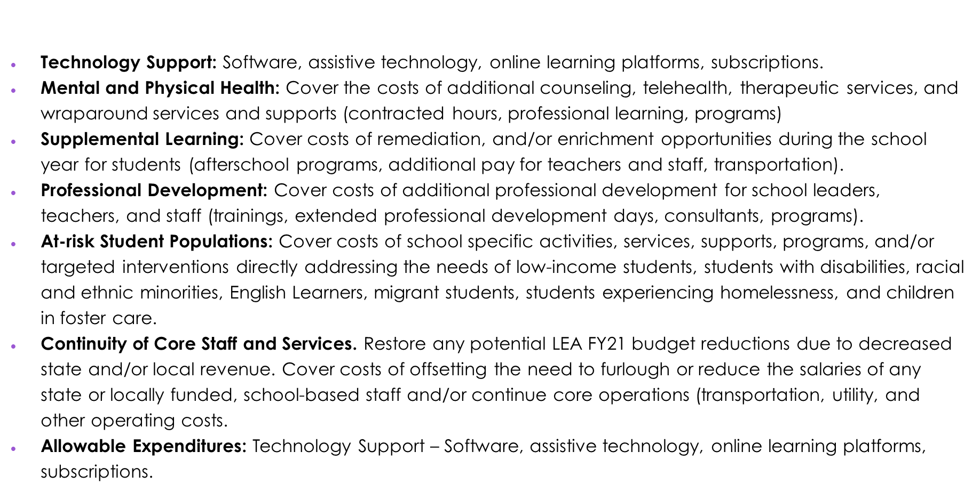
Other Allowable Expenditures

Slide 18
CARES II ACT FUNDS
Description | Budget
Instruction (Tutorials, Professional Learning, Supplemental Learning, Materials and Supplies) | $111,744
Salary Budget (Math Interventionist) | $99,517
Total Budget | $211,261

Slide 19

RESOURCE ALIGNMENT:
Professional Learning, Supplemental Learning & Material and Supplies
Continue instructional intervention and tutorial programs
Provide opportunities ongoing teacher development through professional learning and conferences
Cover costs for resources, activities, and supplemental supports for our at-risk populations
Technology Support: Software, assistive technology, online learning platforms, subscriptions
Create more opportunities personalized learning through small group instruction

Slide 20


Recommended Positions
Math Interventionist
(3) Instructional Paras – Literacy Support
(3) Instructional Paras – Math Support

Slide 21

Let’s Discuss

Slide 22

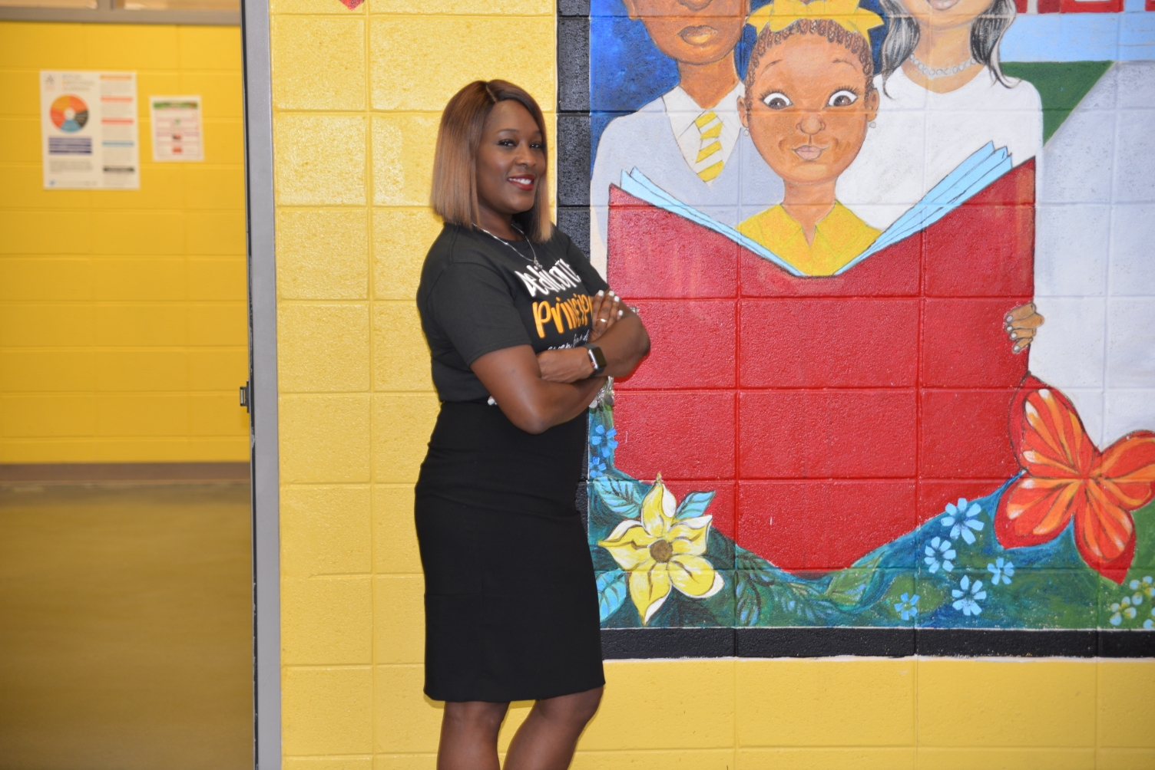
PRINCIPAL’S REPORT
This week we celebrate…
National School Social Worker Week

Slide 23

4th Quarter Intent to Return
Grade | Face-to-Face | Site-Based Virtual | AVA
6 | 29 | 24 | 2
7 | 28 | 14 | 0
8 | 26 | 14 | 0
Total Students | 83 | 52 | 2

Slide 24

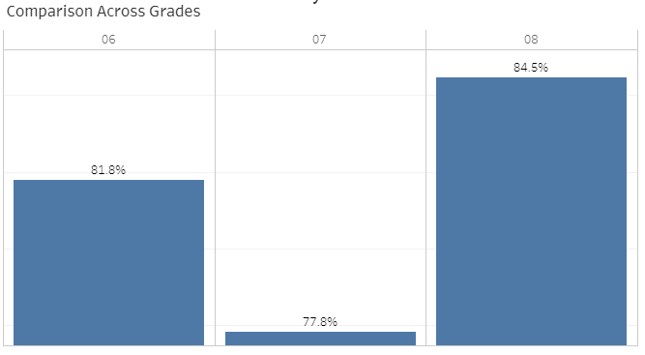
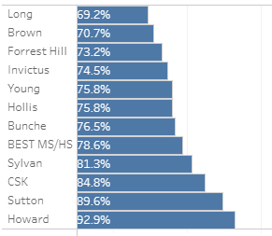

Slide 25
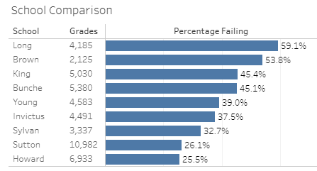
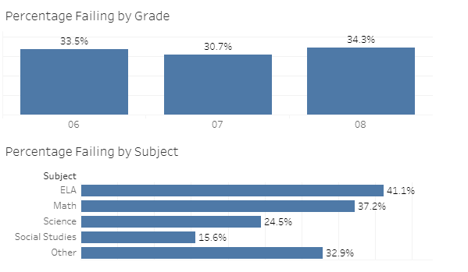
Percentage of Failing Grades

Slide 26

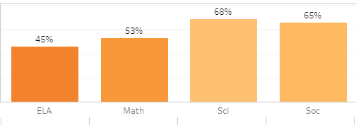
District Benchmark
Sylvan
Take Rate:
58%
ELA
Math
SCI
SS

Slide 27


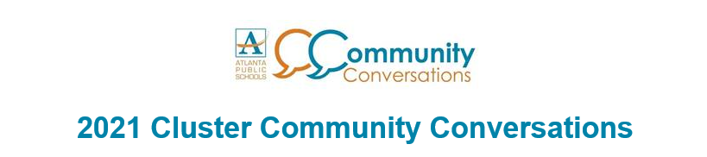



Announcements
Q4 Intent-to-Return to APS schools for the 4th Quarter closed on Monday, March 8th.
Community Cluster Conversations
March 8th – March 24th
π Day
May 11, 2021
5PM- 6:15PM
GO Team Meeting
May 12, 2021

Slide 28
Public Comment Format
Sylvan Hills Middle School's GO Team welcomes input from students, staff, parents and community members during designated meetings. This includes an opportunity for public comment at the end of the meeting not to exceed 20 minutes. To register for an opportunity to speak, please adhere to the following:
1. Register at the sign-up table (google form will be available for virtual meetings) no later than 30 minutes prior to the Go Team meeting dates.
2. Please include your name, email address, and topic.
3. Community members signing up to speak will be given two (2) minutes.
4. The Go Team cannot take public comment on personnel issues.

Slide 29

Meeting Adjourned

